Slide 1

Notes:
Welcome to [organisation] and to the ESTP classroom course________________________
I am [NAME, SURNAME] and
I would like to say a few words about the European Statistical Training Programme or for shorter the ESTP

Slide 2
What is the ESTP?
ESTP is a specialised training programme coordinated by Eurostat
It aims at:
raising the overall quality of European statistics;
raising the qualification of statisticians in the ESS in order to promote their independence in line with the European Statistics Code of Practice;
encouraging both theoretical and practical learning and development;
encouraging the exchange of best practices, know-how and experience;
regularly identify new fields for courses, allowing training program participants to get new qualifications.
Notes:
Firstly,
What is the purpose of the ESTP?

Slide 3

ESTP Target group
Primarily addressed to staff from European National Statistical Institutes (NSIs), Other National Authorities (ONAs) in the European Statistical System (ESS) and Eurostat.
Applicants from other administrations, international organisations and non-European countries may be admitted depending on available places.
Students at universities offering education related to Official Statistics, specially EMOS students may also be admitted, depending on the available places and course goals.
Notes:
Who can attend the ESTP courses?
Staff of NSIs or corresponding ONAs of EU Member States, EFTA countries, candidate countries and Eurostat can apply.
Occasionally, and on an individual basis, also applicants from other administrations, international organisations and statistical offices of non-European countries may be admitted, if places available.
Students of universities offering education related to Official Statistics, specifically EMOS students may be admitted, depending on the course goals.

Slide 4
Course organization
Any training fees? NO
  ESTP trainings are free of charge and financed by Eurostat
    (However, travel expenses and daily allowances are not covered)
Where do ESTP courses take place?
  Luxembourg
  EU Member States
  EFTA countries
  Online
Presence list must be signed every day to get the Certificate of attendance
Notes:
TRAINNIG FEES? Eurostat, the Statistical Office of the European Union, is financing the ESTP training courses, therefore attendance is free of charge.
WHERE ARE THE ESTP COURSES ORGANISED?:
The so called ESTP in-house courses, organised by Eurostat, take place at Eurostat premises
The external ESTP courses are organised by Eurostat contractors, often in cooperation with NSIs
Normally, 2-3 ESTP courses per year are financed/organised by EFTA through EFTA NSIs

Slide 5
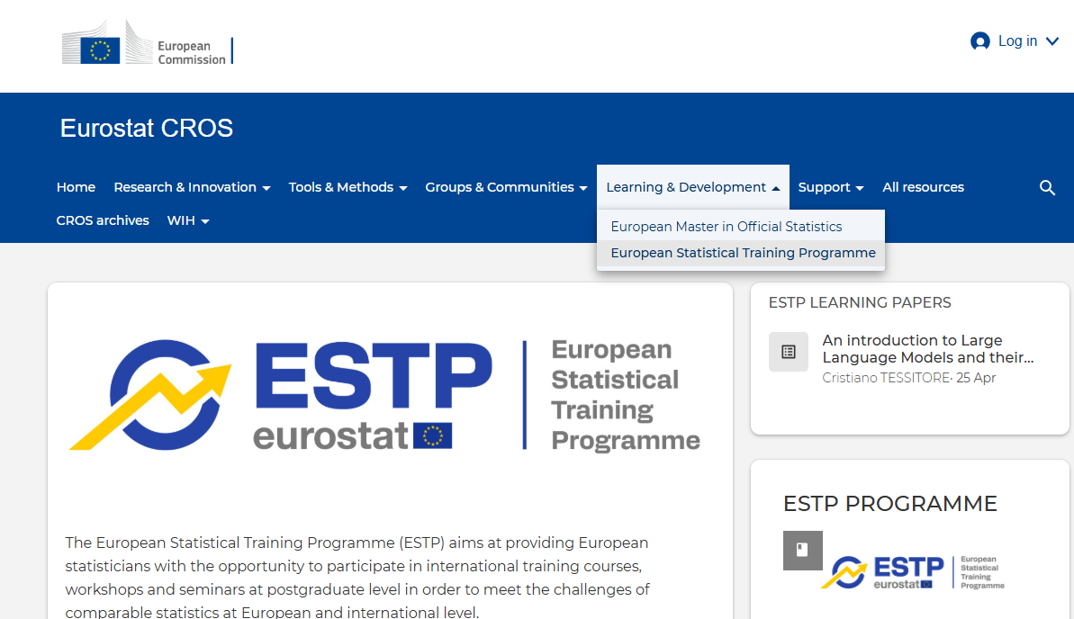
For more info
https://cros.ec.europa.eu/dashboard/estp-dashboard
Your ESTP National Contact Point: https://cros.ec.europa.eu/book-page/national-estp-contact-points
Material of courses available at ESTP group in CIRCABC: https://circabc.europa.eu/ui/welcome
Contact Functional Mailbox: estat-estp-contacts@ec.europa.eu
Notes:
Do you need more info on the ESTP trainings?
The 2026 ESTP programme includes:
43 classroom courses and webinar trainings + 4 Masterclasses
With topics covering: many statistic topics, IT, data collection…..
Visit the Eurostat CROS website to check the ESTP catalogue. Should you find a training course you would like to attend, contact your ESTP National Contact Points by email.
All the material for all courses, going back a few years, is available in the CIRCABC and you are welcome to use them for any purpose you see fit
For international organisations or in case you cannot find what you are looking for, please contact [us] @ estat-estp-contacts@ec.europa.eu
Eurostat’s [our] team will be happy to help you!

Slide 6
Course logistics
Attendance list to be signed every day
Coffee breaks and refreshments
Lunch
Social event (dinner)
Certificates of attendance distributed
the last day
Notes:
Dear Contractor, if there is a lunch or other social event organised for the participants to be mentioned at this point.

Slide 7

Your opinion matters…
Fill in the e-survey to help us improve
THANK YOU!
ENJOY THE COURSE!
Notes:
Please help us improve by filling in the e-survey which you will receive by email by the end of the course.

